Slide 1
Chapter 4 :
Input & Output devices
Visit for more Learning Resources

Slide 2
Scanner
Introduction:
Scanner is an input device.
It reads the graphical images or line art or text from the source and converts it into digital information and send it to the computer.
Scanner is electronic device that scans data.
Scanners are used to give large volume of data as input to the computer.

Slide 3
Types of scanner
Flat bed scanners
Sheet fed scanners
Hand held scanners
Drum scanners

Slide 4
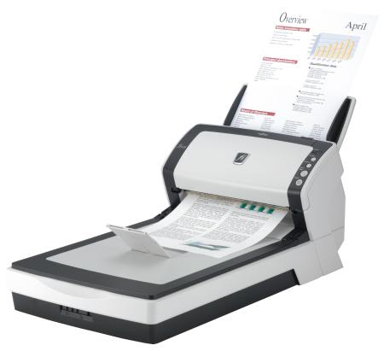
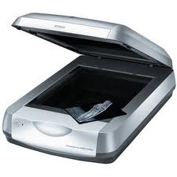
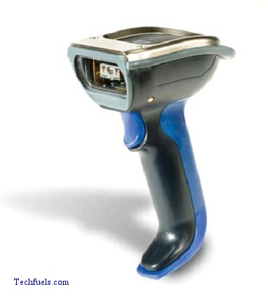
Flat bed scanners
Sheet fed scanners
Hand held scanners

Slide 5
Flatbed scanner
Scan documents, photos, flat object from a PC or laptop.
Works like copy or Xerox machine.
Flatbed is made up of glass pane and moving CCD array and two mirrors.
Most common type of scanner easy to operate, widely used.

Slide 6
Flatbed scanner specification
Scanner type: flatbed
Size:280*486*52mm
Weight :1.7kg
Interface:USB1.0
H/W reslution:1200DPI.
AC voltage:200-240V 50Hz

Slide 7
Sheet-fed scanner
Sheet-fed Scanner smaller and portable
Used to scan document and photos
Document is fed into horizontal and vertical slot provided with scanner
Components of scanner sheet-feeder, scanning module & calibration sheet.
Scan single page documents.
Not used to scan thicker objects.

Slide 8
Handheld scanner
Smaller in size.
It is scanning device which is moved over the object that needs to be scanned .
To scan the document drag the scanner over document.
Used in barcode scanner.
Image quality is very poor.

Slide 9
Drum scanner
Used in publishing industry.
Color drum scanners use three matched photo multiplier tube.
High resolution high quality.
More Expensive.
Drum scanners are slow.

Slide 10
Modem
Introduction:
A modem [Modulator -Demodulator] is a device.
Data communication means transmitting digital information form one computer to other computers through the comuunication channels.
Communicate equipment used for long distance data transfer through telephone lines.
A pair of modems are needed to communication

Slide 11
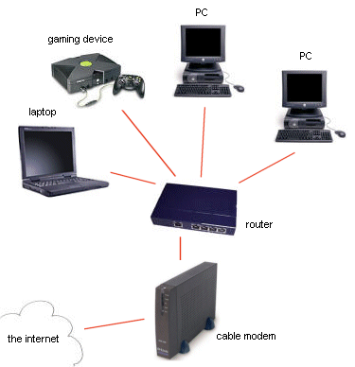
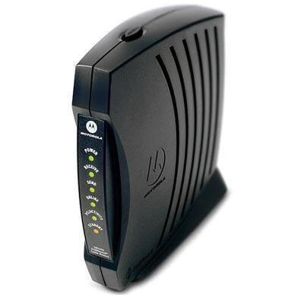
Modem

Slide 12
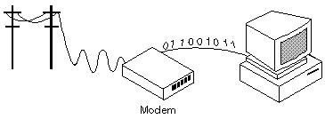
Cont.,
Communication between computers through the existing telephone cables.

Slide 13
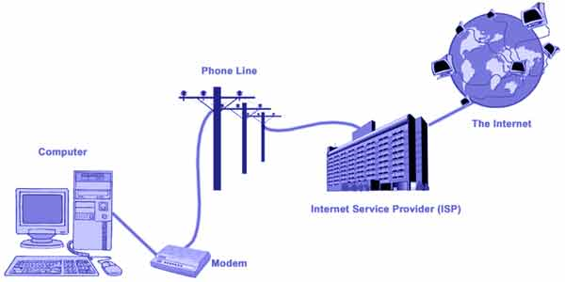


Structure of data communication through modem
Analog data
Digital data

Slide 14
Working principle
The digital data from the computer is converted into analog data by the modem and are transmitted over the telephone line.

Slide 15
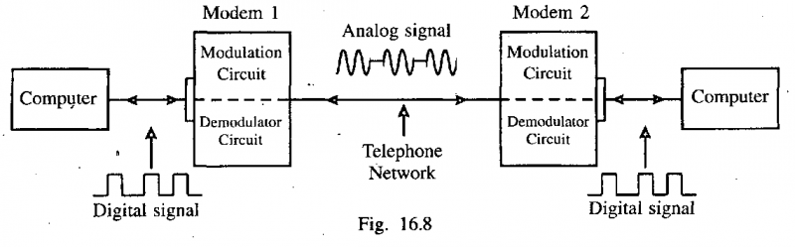
Cont.,
The analog data received from the telephone line is converted to digital by the modem and is given to the computer.

Slide 16
Modulator
This unit is used to convert the digital data from computer into analog data. This process is called modulation.
This is done by adding a carrier signal to the digital signal.

Slide 17


Cont.,
1
0
1
0
1
0
1
1
0
0
1
Amplitude
modulation

Slide 18
Demodulator
This unit is used to convert the analog data from telephone system into digital data.
This is done by eliminating the carrier signal from analog signal.
1
1
0
1
0
1
0
1
0
0
1
Demodulation

Slide 19
Types of modems
Two types of modem.
External modem
Internal modem

Slide 20
External modem
External modem is separate device and is kept outside the computer.
A 9 pin (DB9) or 25 pin serial cable connects the PC serial port to the modem. Thus CPU need not be opened during modem installation.
External modems avoid hardware conflicts such as (conflict of I/O address lines and that of interrupt lines) the external modem setup is faster and easier than internal modems.

Slide 21
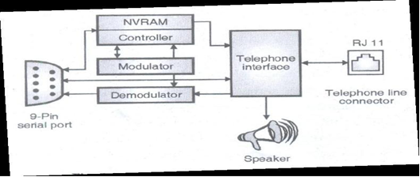
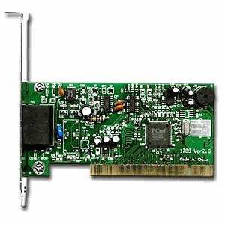
External modem

Slide 22
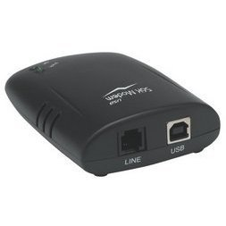
Internal modem
Internal modem is a part of the computer and is connected inside the system.

Slide 23
Internal modem
Internal modem that plugs directly into PCI or ISA expansion slot.
Modem contain its own synchronous receiver/transmitter (UART).
modulator converts digital data from computer into analog signal which is transmitted through RJ-11 jack.
On receiver side receive the analog signal and pass them to demodulator it converts signal and sends to UART.
It then converts serial bit data into parallel byte

Slide 24
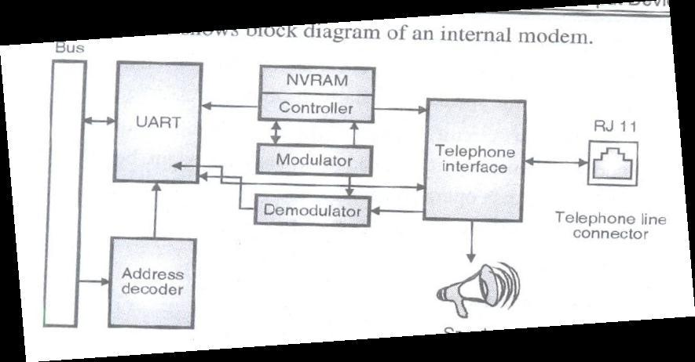
Internal modem
Controller is used to manage overall operation of modem
NVRAM it stores modem parameters

Slide 25
Installing
Switch off the computer and connect the modem.
The computer is switched on , it detect the modem and displays new hardware found dialog box.
Insert the installation CD.

Slide 26

www.ustudy.in
Printer :
Printer is an output device.
This is used to take hard copies of any computer based application.

Slide 27
www.ustudy.in
Types of printer
Dot matrix printer
Ink jet printer
Laser printer
For more detail contact us

